Slide 1
5th / 6th Grade
Mrs. Newell 5
Mrs. Loveridge 5
Mr. McGuffey 6

Slide 2
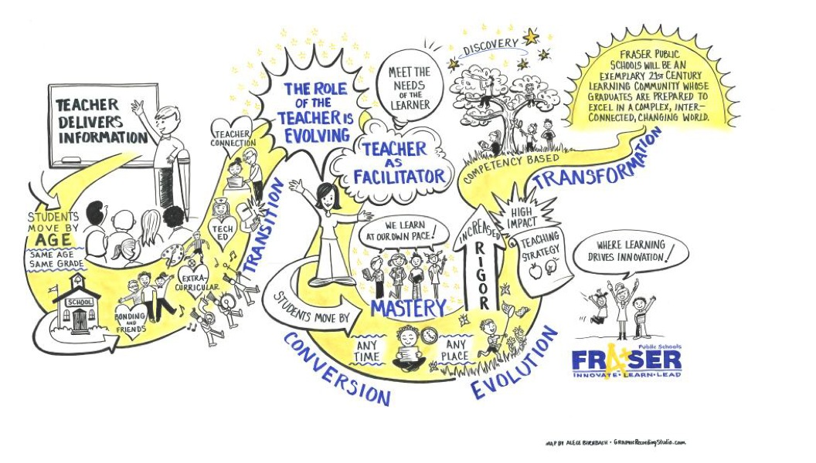

Slide 4
Text @message to phone #
HOMEROOM TEACHER
Mrs. Newell
@6da0fc (586) 580-4092
Mrs. Loveridge
@lover (301) 979-7738
Mr. McGuffey
@mcguffey (989) 301-4449
CONTENT AREA
Reading
@mrsnewells (586 )580-4092
Writing
@56write (301) 979-7738
Math
@mcguf (989) 301-4449

Slide 6
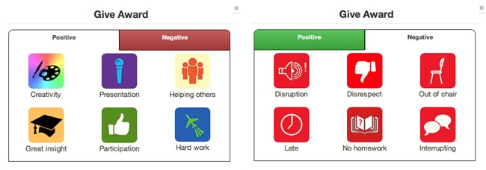
Positives
CIA Student
Working Towards Goal
Helping Hand
Work in Progress
Conversation
Help
Activity
Movement
Participation
= success

Slide 7
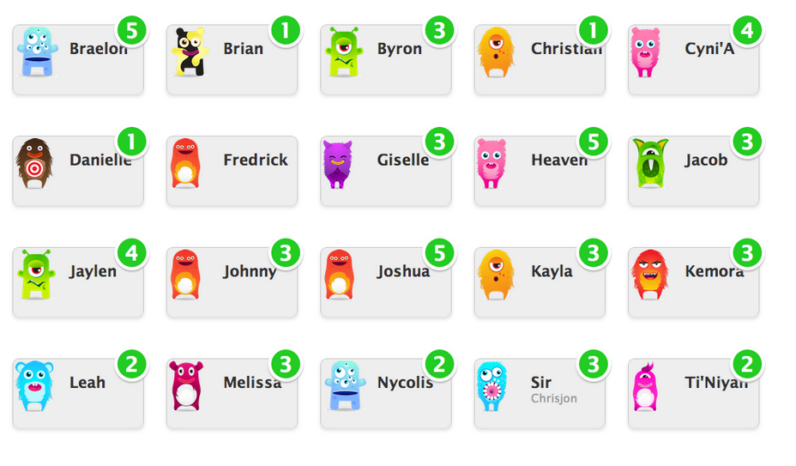

Slide 8
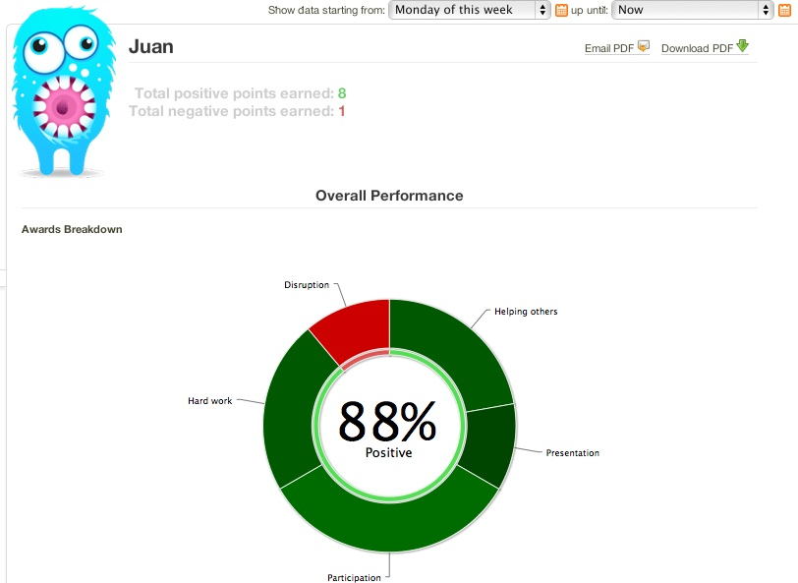

Slide 9
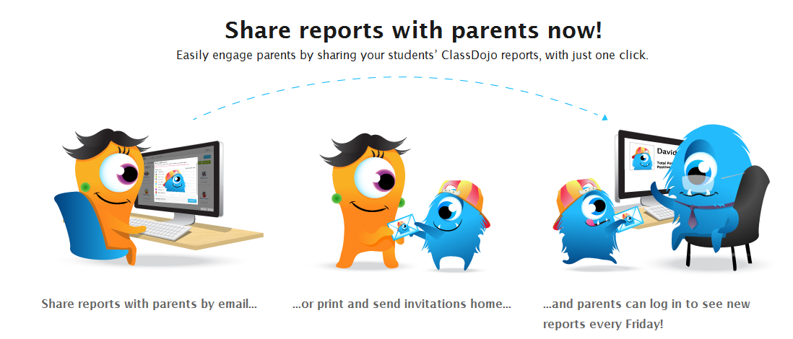
Please ask for your personal CODE to check in

Slide 15
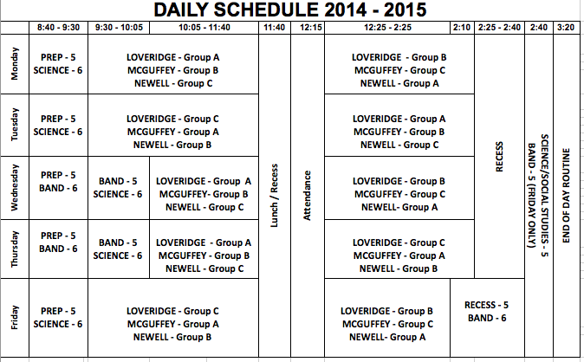

Slide 16
RATIONALE FOR SCHEDULE
Longer blocks of time allow us to “dig deeper” into content in the core areas (reading, writing, math).
Flexibility will allow students to float between groups if they need more time in a particular subject area
Students will have a block of time with their homeroom teacher and class every day.

