Slide 1
Welcome to Mrs. Newell’s Class!
5th Grade Science
5th and 6th Grade Reading

Slide 2
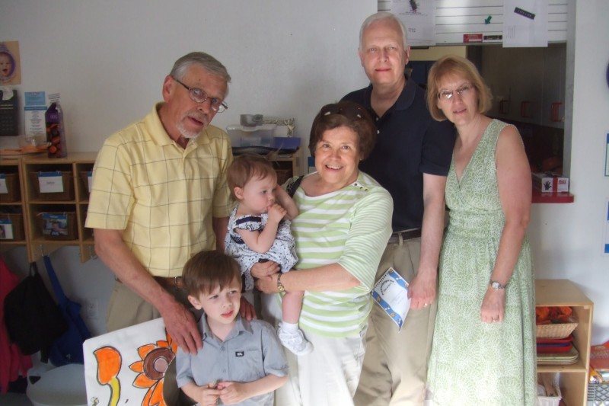
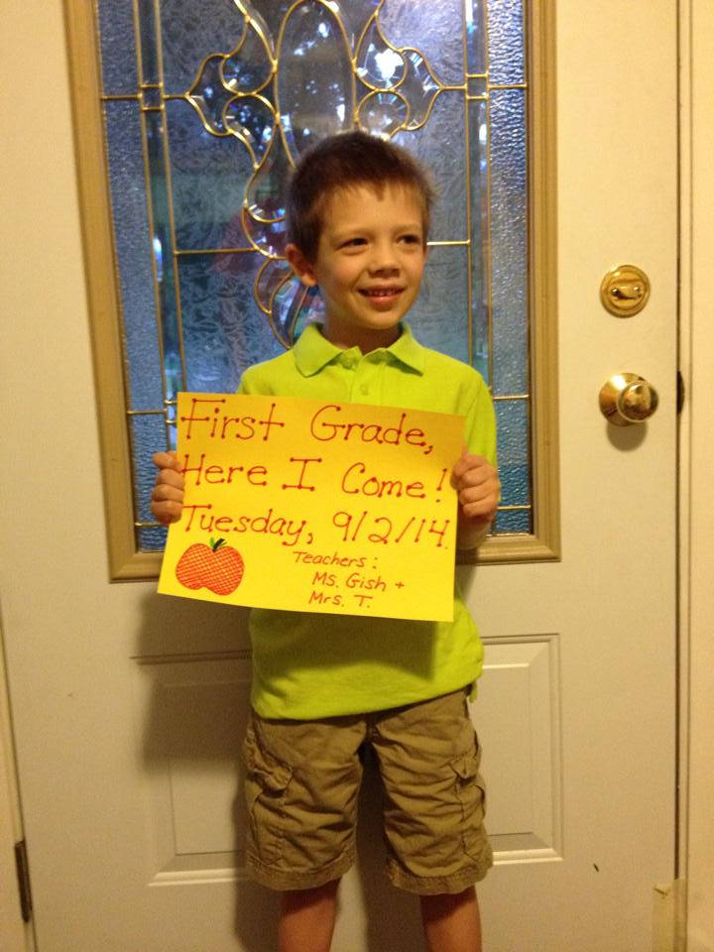
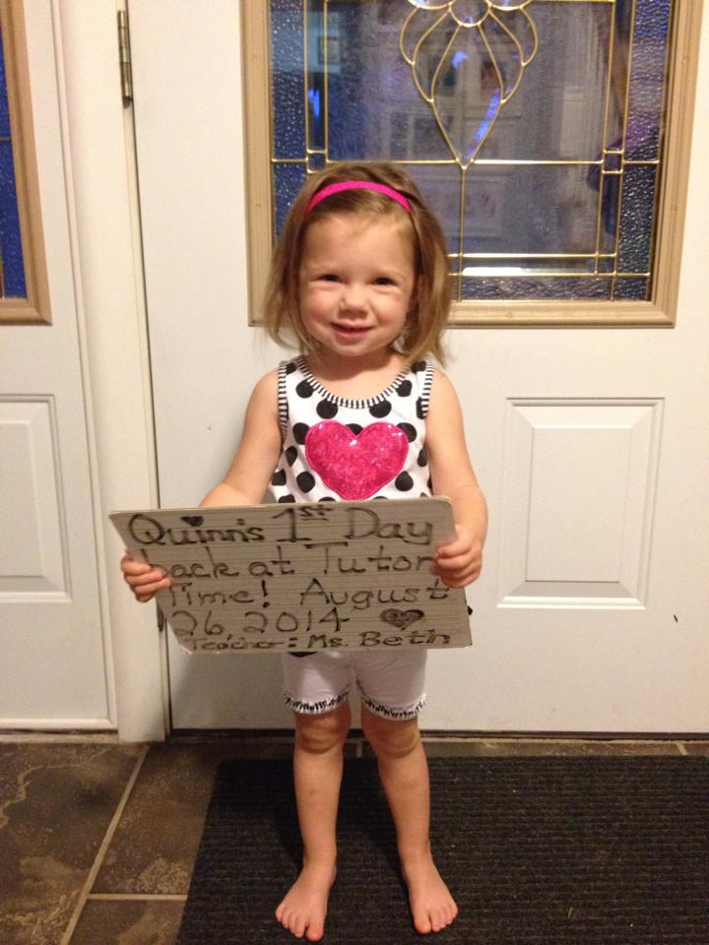
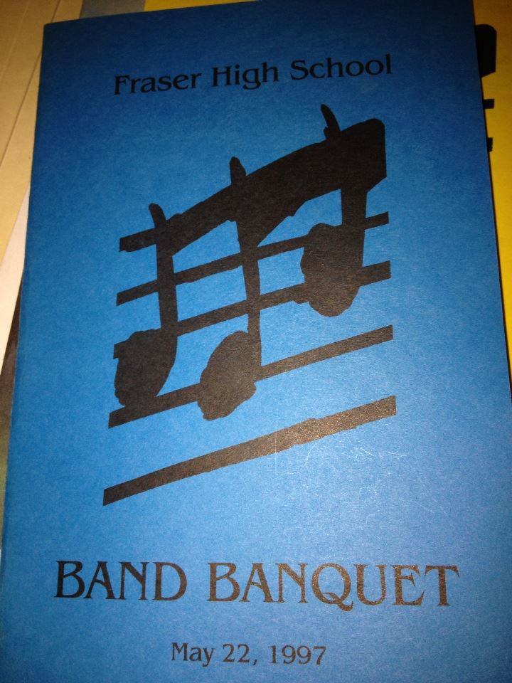
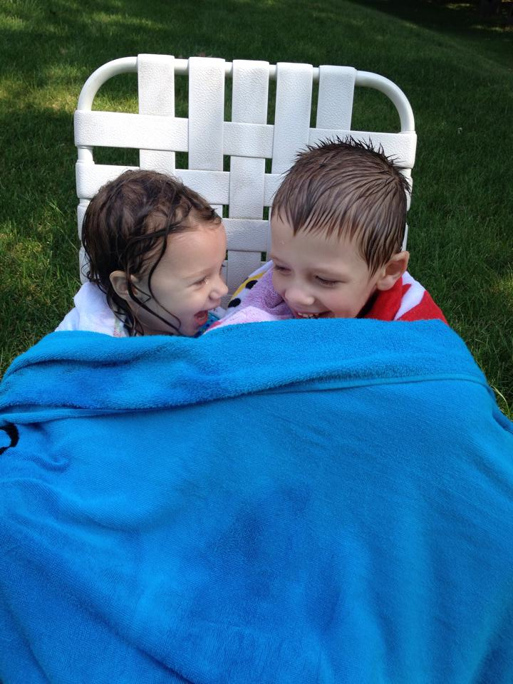
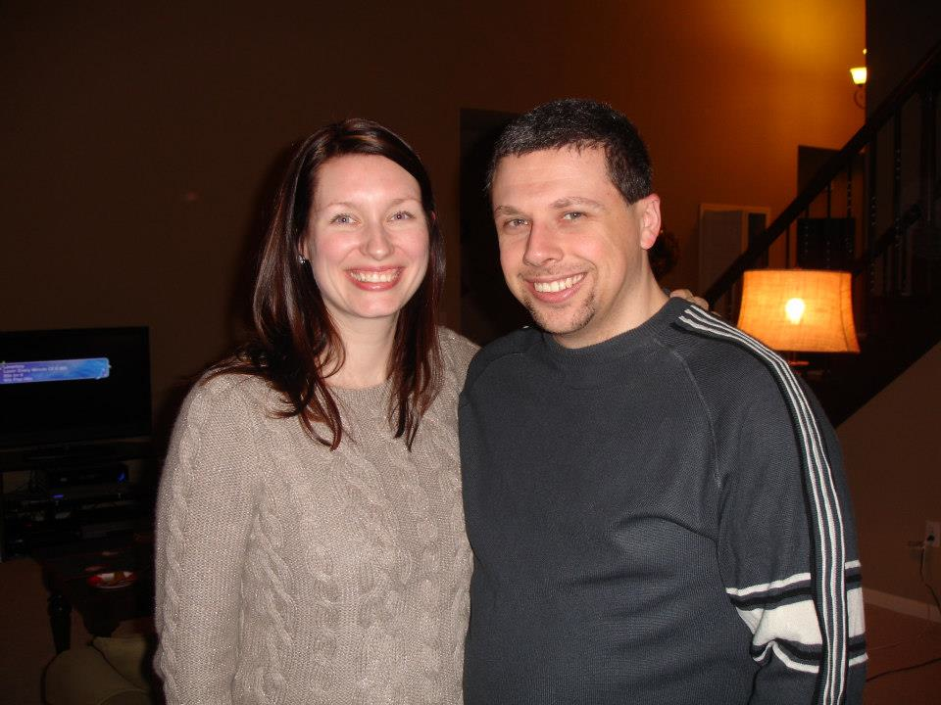

Slide 3
Standards Based Learning
Grade book will list student performance by STANDARD rather than by assignment.
Students, parents, & teachers will better know what students do and don’t know.
Grades will be a more accurate reflection of learning.
Students will be motivated to keep learning and improving on critical skills.
Students who excel will be challenged to do even better.

Slide 4
Reading “Grades”
Students do not receive a letter grade for reading on their report card, but simply a B, D, or S.
Students will be assessed several times on each skill via individual conferencing with the teacher. The highest score achieved will be reflected in the grade book.
The grade book system only operates on total points and percentages. Therefore:
100% = SECURE
75% = DEVELOPING
50% or 0% = BEGINNING

Slide 5
Reading Class Structure
First 20 minutes: Students engage in RTS. Teacher holds individual conferences with students to discuss goals and progress on standards.
Next 10 minutes: Mini-lesson on reading comprehension
Next 20 minutes: Students work on assignments for Daily 5 option of their choice: RTS, RTB, WWW, EV. Teacher runs guided reading groups.
Next 10 minutes: Mini-lesson on expanding vocabulary
Next 20 minutes: Students work on assignments for Daily 5 option of their choice: RTS, RTB, WWW, EV. Teacher runs guided reading groups.
Last 40 minutes: Various students work on Genius Hour activities. Teacher works with other students on Genre Units.

Slide 6
Reading Activities
CAN DO and MUST DO choices in the areas of RTS, RTB, WWW, and EV.
What Stuck With You?
Class Search
Genre Units
5th Grade: Indian in the Cupboard, Sign of the Beaver, The Fighting Ground
6th Grade: The Cay, Jason’s Gold, Ella Enchanted
CCR
Socratic Circles
Genius Hour
Online Portfolios
Pop Into a Good Book!

Slide 7
5th Grade Science
Three Units of Study:
OBJECTS IN THE SKY
FORCE AND MOTION
SYSTEMS AND SURVIVAL
First Field Trip: Tuesday, September 30 to Cranbrook Science Center – SEE ME FOR CHAPERONE FORMS! Permission Slips will be coming home soon with your child.
Also utilizes standards based learning. Your child will receive a letter grade (A, B, C, D, E) in science.

